Slide 1


DEPARTMENT OF COMPUTER SCIENCE AND ENGINEERING
20CS7503 & DESIGN PROJECT – III
END SEMESTER PRACTICAL EXAMINATION- NOV / DEC 2025
REVIEW PRESENTATION
Batch No: 03
Date: 01-12-2025
Session: FN

Slide 2
AI POWERED PETITION ANALYSIS AND CATEGORIZATION USING NLP
Guide Name:
M. MATHUMATHI, M.E., (Ph.D.,)
Team Members:
ABINESH R (811722104005)
ANBAZHAGAN P (811722104011)
HARIBHARATHI R (811722104047)
INFANTALAN L (811722104057)

Slide 3
OBJECTIVE OF THE PROJECT
To enable users to submit petitions digitally with support for text, PDF, and image uploads for flexible and convenient reporting of public issues.
To automatically analyze uploaded content (text, PDF, or image) using AI techniques such as NLP and Image Captioning to extract sentiment, urgency, and priority.
To accurately detect and prevent repeated petitions through duplicate identification based on text and image similarity, improving system efficiency.
To provide an organized workflow where admins can manage petitions, update status to ‘Solved’, and ensure solved petitions are removed from the active display.
To enhance transparency and decision-making with a clean dashboard that visualizes petition trends, solved vs unsolved counts, and priority-based analytics.

Slide 4
INTRODUCTION
The Petition Analysis System is an AI-powered digital platform designed to help citizens submit public issues online and track their status transparently. Traditional petition handling is slow, manual, and lacks clarity in prioritization and follow-up. This system analyzes uploaded petitions using advanced techniques such as NLP for text and BLIP image captioning for photos. It automatically determines sentiment, urgency, priority, and detects duplicate petitions to improve resolution efficiency. Admins can manage, solve, and monitor petitions through a real-time analytics dashboard. The system enhances communication between the public and authorities, enabling faster and more organized grievance resolution.

Slide 5
LITERATURE SURVEY
TITLE OF PAPER | AUTHOR(S) | PAPER GIST | TECHNOLOGY USED
AI-Based Grievance Redressal Using NLP | Dr. R. Kumar & Team | Focuses on classifying citizen complaints using sentiment analysis. However, the system only works on text and cannot process PDF or image inputs. | Sentiment Analysis, SVM
Automated Priority Prediction of Public Complaints | S. Banerjee & A. Iqbal | Predicts priority levels for complaints, but lacks support for urgency detection and duplicate identification. | Machine Learning (Random Forest), Text Mining
Image-Driven Public Issue Detection | M. Shah & Group | Uses image processing to detect road and drainage issues visually, but does not generate meaningful text descriptions or integrate complaint workflow. | CNN, Deep Learning

Slide 6
LITERATURE SURVEY
TITLE OF PAPER | AUTHOR(S) | PAPER GIST | TECHNOLOGY USED
Smart Online Complaint Management System | P. Singh & K. Mehta | Provides online complaint submission and admin monitoring, but solved issues remain mixed with active issues and no duplicate checking system. | Web Technologies, MySQL, Basic Dashboard
Deep Learning-Based Public Feedback Categorization System | R. Patel & S. Verma | Categorizes feedback using deep learning models, but does not support file uploads (PDF/Image) and lacks dashboard analytics. | Deep Learning, LSTM,

Slide 7
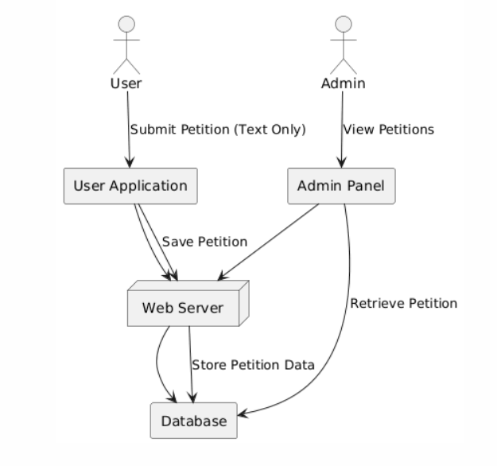
EXISTING SYSTEM ARCHITECTURE

Slide 8
PROBLEM IDENTIFICAITON
Existing petition systems only support basic text-based submission and lack image-based captioning, making it difficult to understand visually reported issues without manual review.
There is no mechanism for duplicate petition detection, which results in repeated submissions of the same issue and increases processing time and workload.
Absence of a real-time analytics dashboard prevents authorities from tracking trends, prioritizing critical issues, and analyzing petition performance effectively.
No social interaction features such as likes and comments limit user engagement and public support for high-impact petitions.
Current systems provide only basic classification without urgency rating, keyword extraction, or admin solving workflow—leading to poor issue prioritization and lack of visibility between solved and unsolved petitions.

Slide 9
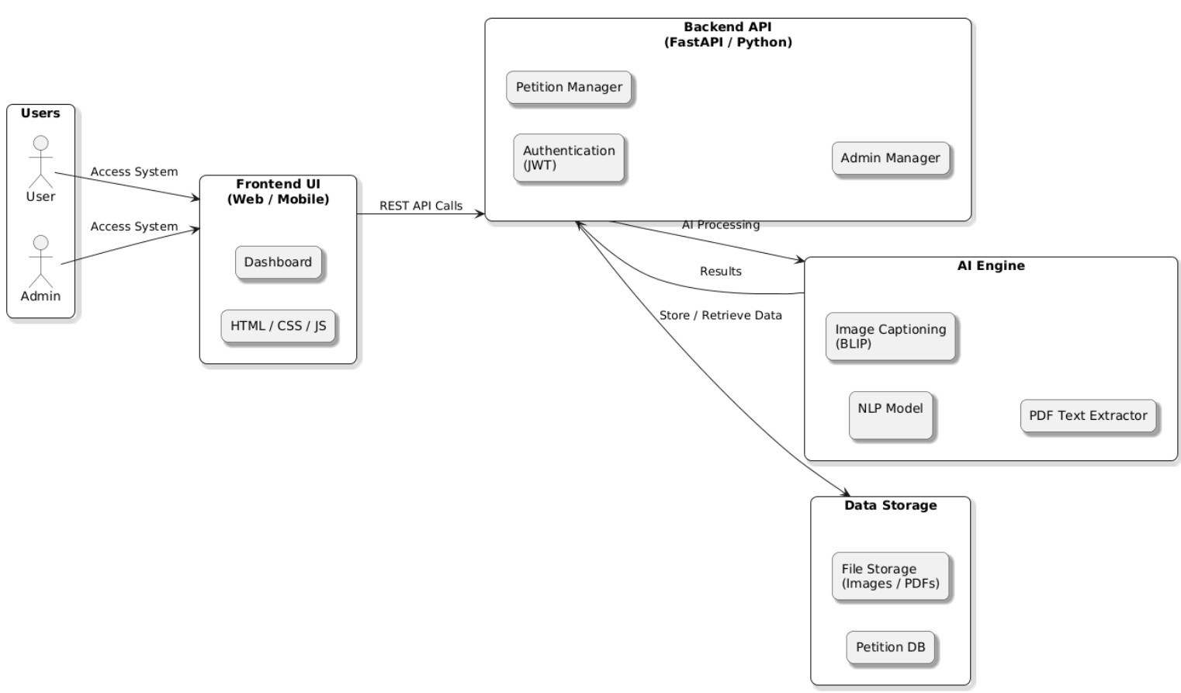
PROPOSED SYSTEM ARCHITECTURE

Slide 10
SOFTWARE AND HARDWARE REQUIREMENTS
HARDWARE
System : PC or Laptop
Processor : Intel i3/i5/i7 or AMD
RAM : Minimum 4 GB
SOFTWARE
Windows 10 or 11
HTML, CSS, JavaScript
Python
Flask

Slide 11
MODULES
1.User Module – For petition submission, tracking, and feedback by citizens.
2.Petition Processing Module – Handles NLP-based classification, urgency detection, and duplicate checking.
3.Sentiment Analysis Module – Analyzes emotional tone (positive, negative, neutral) of petitions.
4.Admin Module – Dashboard for officials to view, filter, and manage petitions.
5.Analytics & Reporting Module – Provides insights like heatmaps, frequency charts, and department-wise workload.

Slide 12
1.User Module
The User Module allows citizens to submit petitions using text, PDF, or image uploads.
Users can track the status of their petitions through the interface.
Image uploads are automatically converted into meaningful captions using AI.
PDF files are extracted into text for better analysis and accuracy.
Users also receive feedback once the petition is solved by the admin.

Slide 13
2.Petition Processing Module
This module handles all backend AI processing of the submitted petition.
It performs PDF text extraction and generates image captions using the BLIP model.
It calculates urgency, priority, and keywords based on combined text inputs.
Duplicate detection compares new submissions with previous solved petitions.
All processed petition data is stored for further tracking and analytics.

Slide 14
3.Sentiment Analysis Module
This module handles all backend AI processing of the submitted petition.
It performs PDF text extraction and generates image captions using the BLIP model.
It calculates urgency, priority, and keywords based on combined text inputs.
Duplicate detection compares new submissions with previous solved petitions.
\All processed petition data is stored for further tracking and analytics.

Slide 15
4.Admin Module
The Admin Module provides officials with a dashboard to manage petitions.
Admins can view all petitions, filter them, and check detailed analysis.
They can mark a petition as “Solved,” which removes it from the user view.
Solved petitions are moved to a separate database list for tracking.
These solved petitions help detect duplicates in future submissions.

Slide 16
5.Analytics & Reporting Module
This module generates visual charts and reports for decision-making.
It shows priority distribution, urgency levels, and sentiment trends.
Admins can see solved vs unsolved petitions in clear graphical formats.
Heatmaps, frequency charts, and workload insights are displayed.
It provides a complete data-driven picture of petition trends and issues.

Slide 17
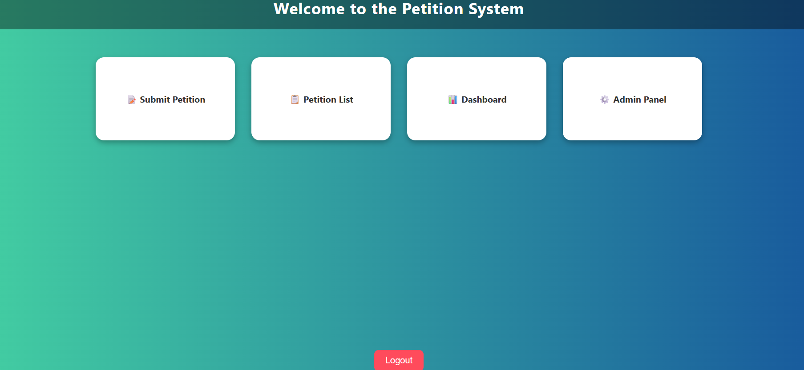

Slide 18
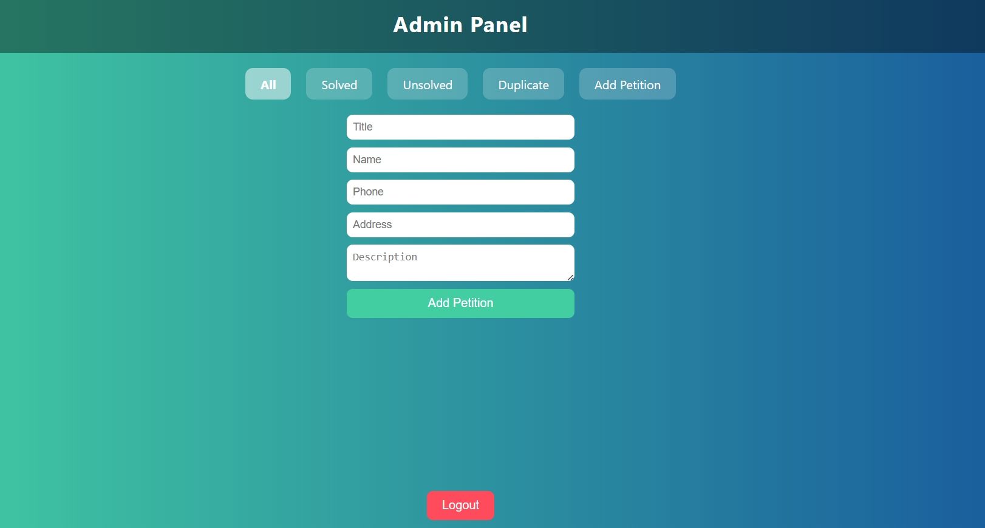

Slide 19
CONCLUSION
The proposed AI-powered petition management system overcomes the limitations of existing manual grievance redressal methods. By integrating NLP and machine learning, it ensures automated classification, urgency detection, and duplicate handling. Sentiment analysis and engagement tracking further enhance prioritization and transparency. Overall, the system improves efficiency, scalability, and citizen trust in digital governance

Slide 20
FUTURE ENHANCEMENTS
Multilingual Petition Processing
Enable petition submission and analysis in multiple regional languages for wider accessibility.
Voice-to-Text Petition Submission
Allow citizens to submit petitions through voice input, making the system more user-friendly for non-typists.
Chatbot Support & Virtual Assistance
Integrate a chatbot to help citizens track status, submit issues, and get instant responses.

